Slide 1
Section 1
Cellular Structure and Function
Cell Discovery and Theory
The Cell Theory
All organisms are composed of one or more cells.
The cell is the basic unit of structure and organization of organisms.
All cells come from preexisting cells.

Slide 2
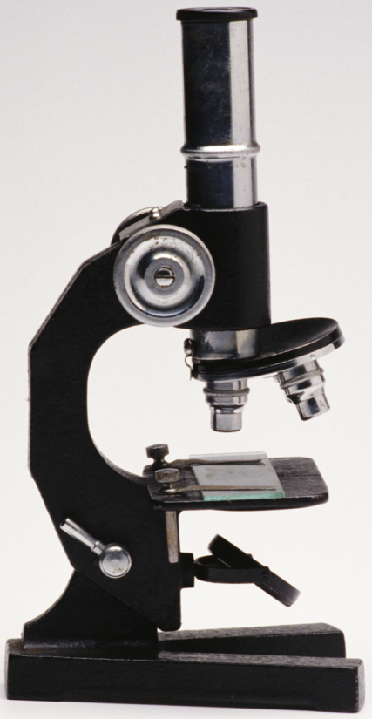
Section 1
Cellular Structure and Function
Cell Discovery and Theory
Light Microscopes
Utilizes a series of glass lenses and visible light to magnify an image
Magnifies images up to 1,000 times the actual size
CMCD/Getty Images

Slide 3
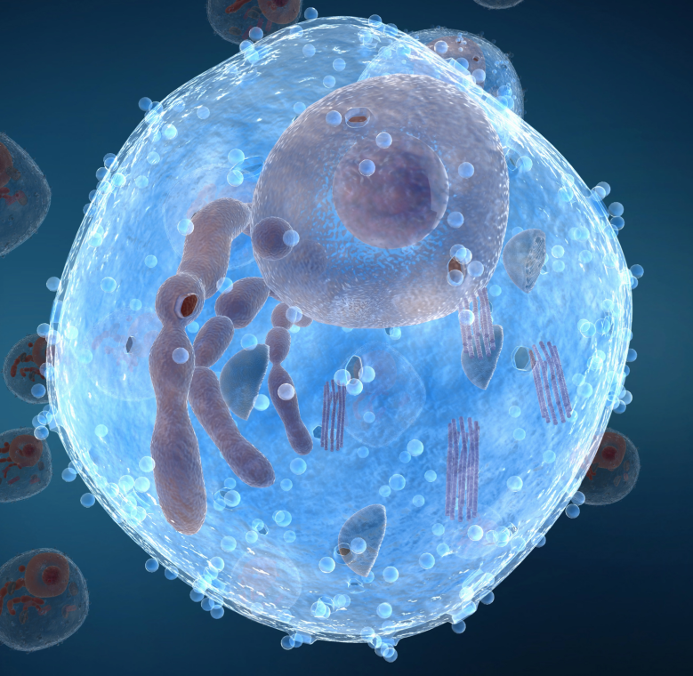
Section 1
Cellular Structure and Function
Cell Discovery and Theory
Electron Microscopes
Utilizes magnets to aim a beam of electrons at
a cell to produce
an image
Magnifies images up to 500,000 times the actual size
MedicalRF.com/Getty Images

Slide 4
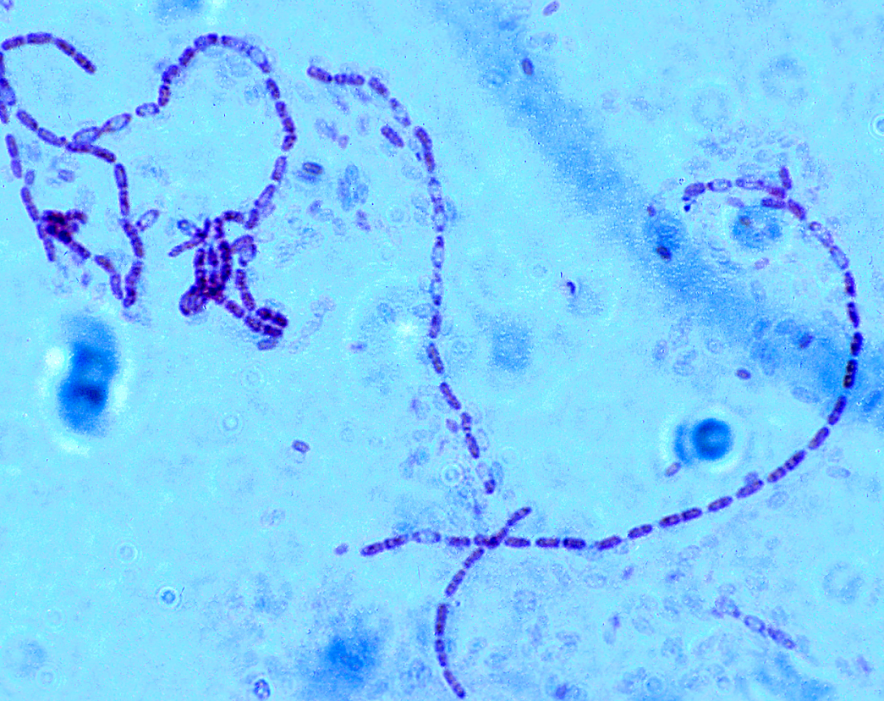
Section 1
Cellular Structure and Function
Cell Discovery and Theory
Prokaryotic Cell
Simple structure
Contains a plasma membrane
Does not contain membrane-bound organelles
Steven P. Lynch

Slide 5
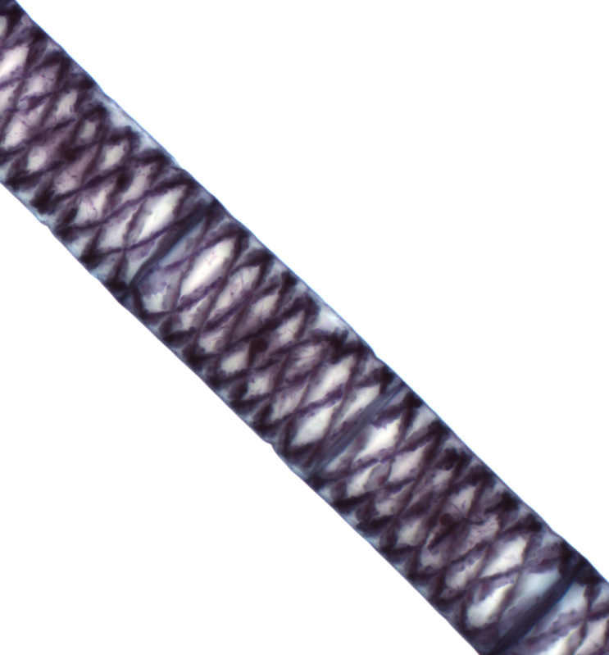
Section 1
Cellular Structure and Function
Cell Discovery and Theory
Eukaryotic Cell
More complex structure
Contains a plasma membrane
Contains membrane-bound organelles
The McGraw-Hill Companies, Inc./Al Telser, photographer

Slide 6
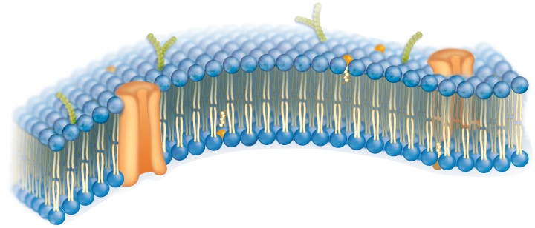
Section 1
Cellular Structure and Function
The Plasma Membrane
Plasma Membrane
Thin, flexible boundary between the cell and its environment
Allows nutrients into the cell
Allows waste to leave the cell

